Slide 1
Public Hearing 2025 Street Reconstruction and Sewer and Water Extension Pine Haven Consider Adopting Assessments
March 24, 2025

Slide 3
Background
June 10, 2024, Approved the Feasibility Study
Identified Cost to be Assessed
July 22, 2024, Public hearing on Improvements
60 day petition period and no valid petitions against the project
Ordered project, approved the plans & specs and authorized the ad for bid, December 9, 2024
Project includes other improvements within the City
Notes:
Age Colonial ~45 yr 4 of 29
PH ~ 45 yr 2 of 30
Well separation required as septic's are replaced proposed challenges especially in PH.

Slide 4
Proposed Assessment
$16,000

Slide 5
Background
Received Bids on February 11, 2025
Bids were within the planned budget
Consider Adopting Assessments, March 24, 2025
Assessment adoption procedures require a public hearing
To appeal the amount of an assessment
Property owner to submit a signed written objection filed with the municipal clerk at the public hearing

Slide 6
Total sanitary sewer and water project cost with contingencies and overhead $1,604,530.00
The proposed funding is as follows:
$480,000.00 Assessments
$1,124,530.00 Trunk Area & Unit Fund
$1,604,530.00 Total

Slide 7
Assessment Amortization Example
$16,000 May be assessed through property taxes 15 yrs (Interest is the City’s bond rate plus 2%)
5% interest rate
1,542/yr
$129/month
Connections NOT required unless non-compliant
Cannot connect until late fall 2025

Slide 8
Costs at the Time of Connection
Connection Fees Standard $7,703 Additional $5,927** | Due at the Time of Connection* | $13,630
Estimated Construction Cost | Private property specific | ~$10,000
MCES Connection Fee | Due with Connection Permit | $2,485
* Can be assessed to spread out the obligation
** Based on Feasibility Cost Estimate – updated upon project completion. Will be amortized annually.

Slide 9
Schedule
Task Number | Task Description | Completion Date
1 | Accept Feasibility and Order Public Hearing | June 10, 2024
2 | Public Hearing | July 22, 2024
3 | 60 days of no action of the City Council Ends | Sept 20, 2024
4 | Authorize Preparation of the Plans and Specifications | October 14, 2024
5 | Authorize the Ad for Bid | December 9, 2024
6 | Award a Construction Contract | March 24, 2025
7 | Start Construction | April 2025
8 | Complete Construction | Spring, 2026

Slide 10
Next Steps
Open the Public Hearing
Hearing on Proposed Assessments
Construction related questions to be addressed by contacting engineering directly

Slide 11
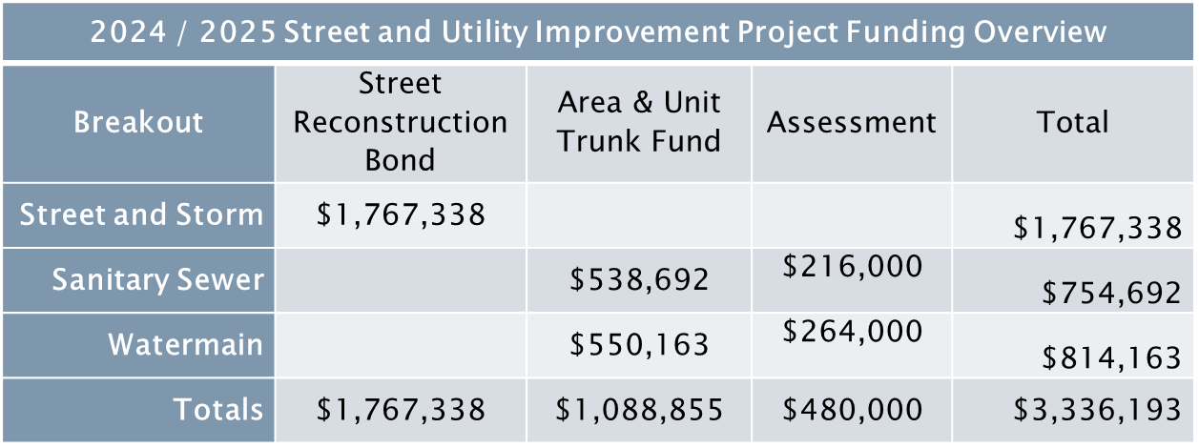
Pine Haven Project Funding
Notes:
Sewer and water funded through assessments and a&u

Slide 12
Pine Haven Project Funding
Notes:
Sewer and water funded through assessments and a&u

Slide 13
Pine Haven Project Funding

Slide 14
Pine Haven Area & Unit Trunk
2024 / 2025 Street and Utility Improvement Project Proposed Detailed Funding
 | Area & Unit Trunk Fund |  |  |  | Total
 | City Funds |  | Property Owner Connection Fees
 | Oversizing | Additional Match Costs | Additional Match Connection | Standard Connection Fee
Sanitary Sewer & Watermain | $510,365 | $177,810 | $177,810 | $222,870 | $1,088,855
Total | $688,175 |  | $400,680 |  | $1,088,855

Slide 15
Consultation with installers determined:
Well replacement $15,000 - $25,000
Septic system replacement $25,000 - $30,000
Avg combined replacement $40,000 - $60,000
Not required to connect
Unless known non-compliance
Compliance determined by an approved inspector
No point of sale requirement
Common for the buyer to require inspection triggering upgrade

